Slide 1

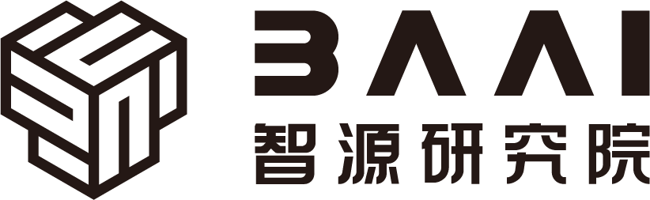

Hardware and Software Fundamentals of Intelligent Computing Systems
Notes:
需要涉及的要点：
- 第一课时：Compute Architectures 的逐渐演化：由AI/ML workload 引导，逐渐展示出多种多样的架构，如华为达芬奇、AMD等等
- 第二课时：互联的硬件基础，与CUDA core、Tensor core 的编程。
- 可能还需要涉及的点：课程整体设计（Syllabus、各个模块的内容，根据教学大纲生成了个overview的图）

Slide 2
Lecture 03: Deep Learning Framework Call Chain Analysis

Slide 3
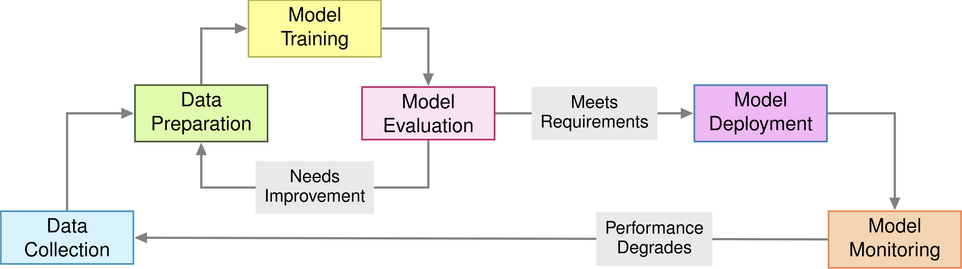
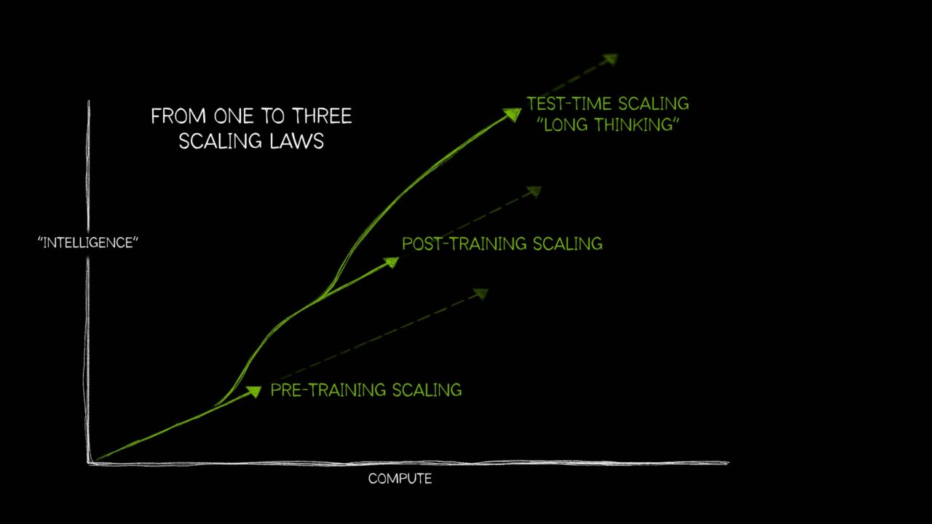
ML System Lifecycle & Three Scaling Laws
pre-train
post-train
serve
develop

Slide 4
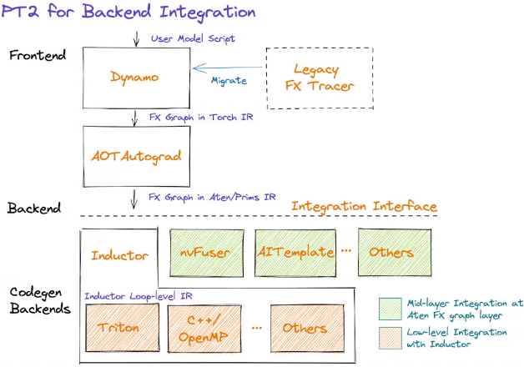
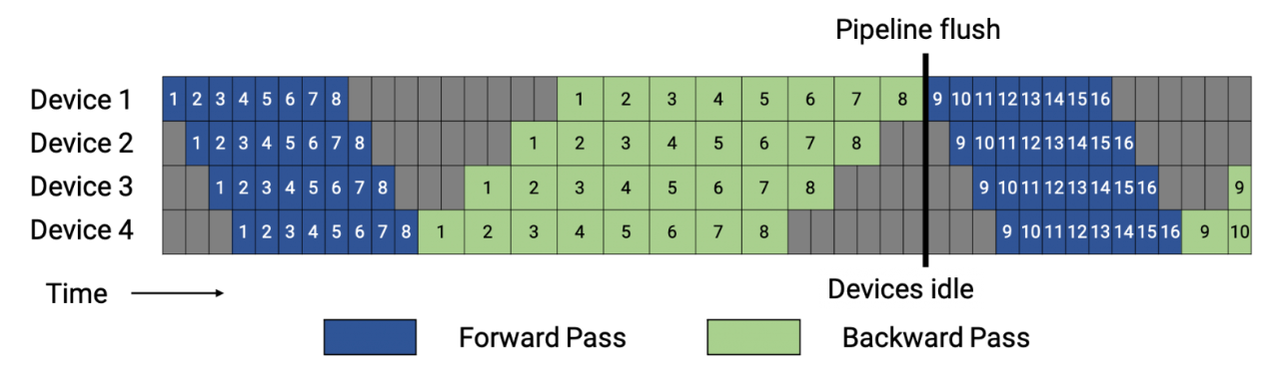
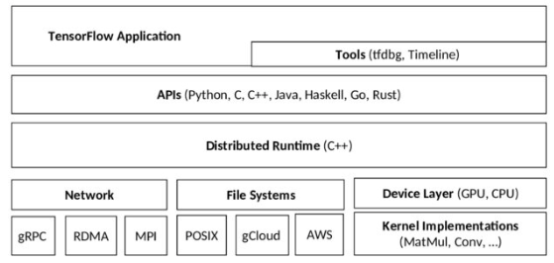
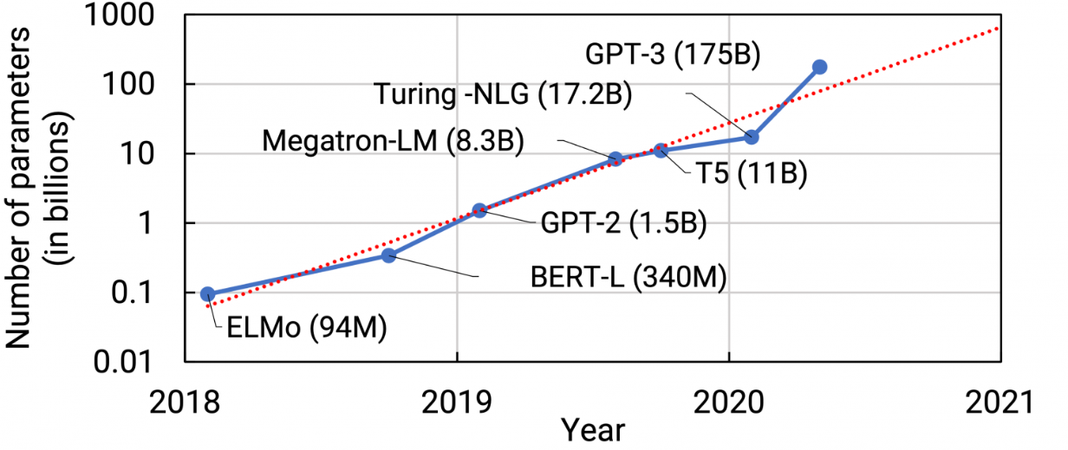
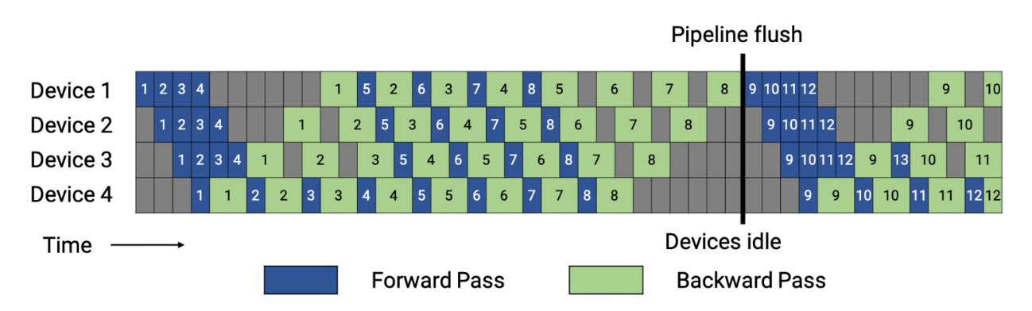
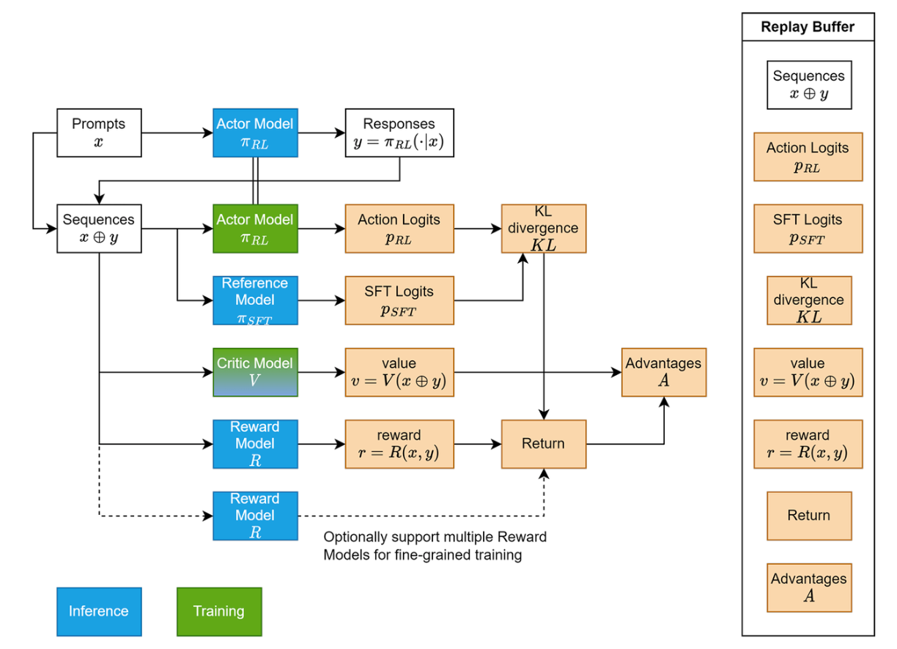
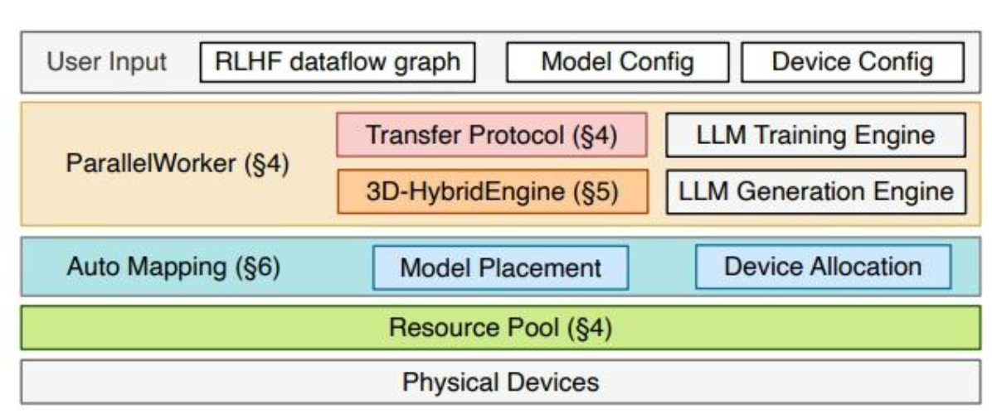
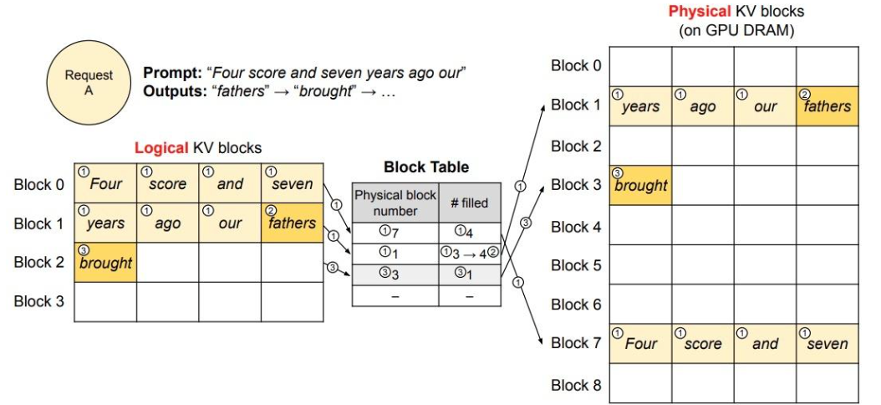
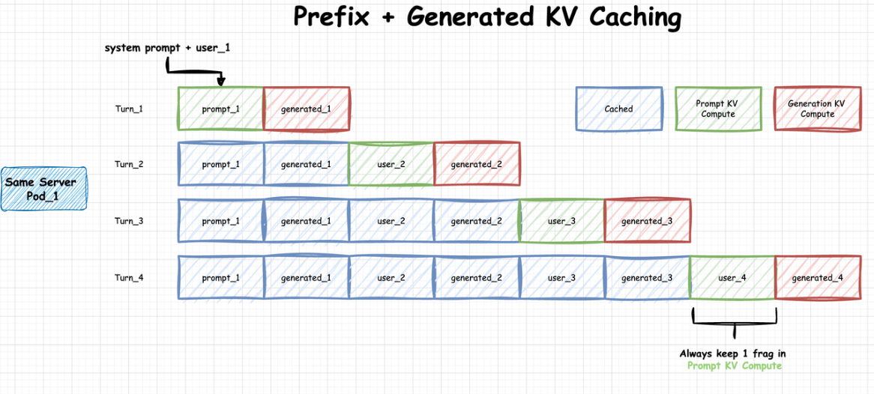
Overview of LLM Software Framework
Basics
Pre-train
PyTorch & Tensorflow
DSL&API, Graph, AutoDiff, Compiler, CodeGen
Megatron-LM & Accelerate
Parallelism Settings, FP/BP Optimization, Redundancy
Serve
Post-train
vLLM & SGLang
Paged Attention, Prefix Caching, Speculative Decoding
OpenRLHF & veRL
Controller & Dataflow Opt, Efficiency & Flexibility
Notes:
Basic ML Framework: PyTorch & Tensorflow.
Efficient LLM Training Framework: DeepSpeed, Megatron-LLM, Accelerate
Efficient LLM Inference Framework: vLLM, SGLang, llama.cpp
Flexible Post Training Framework: verl

Slide 5
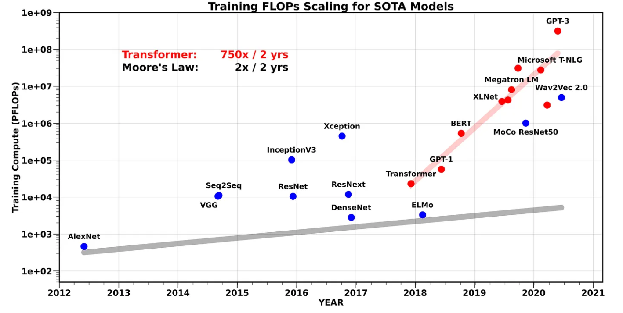
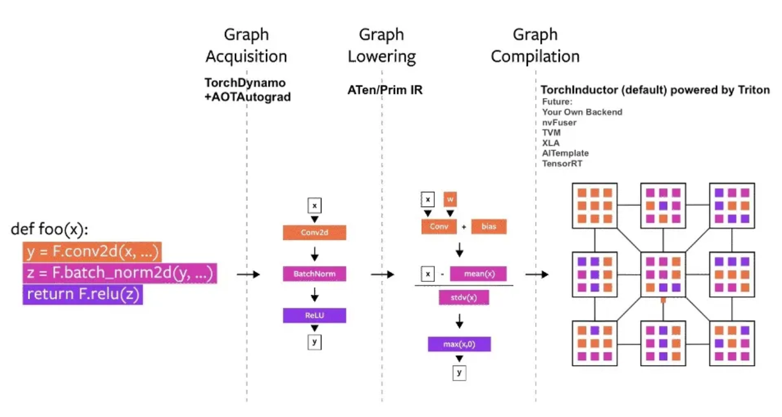
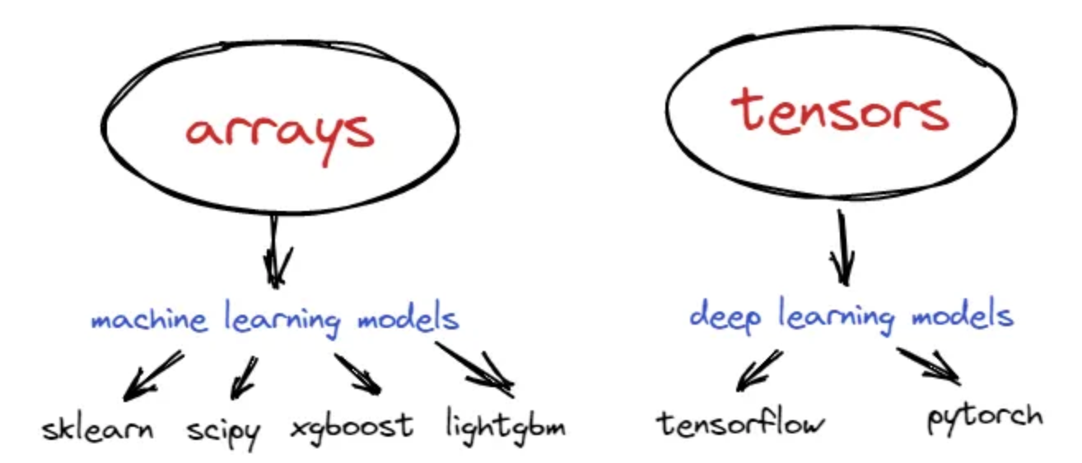
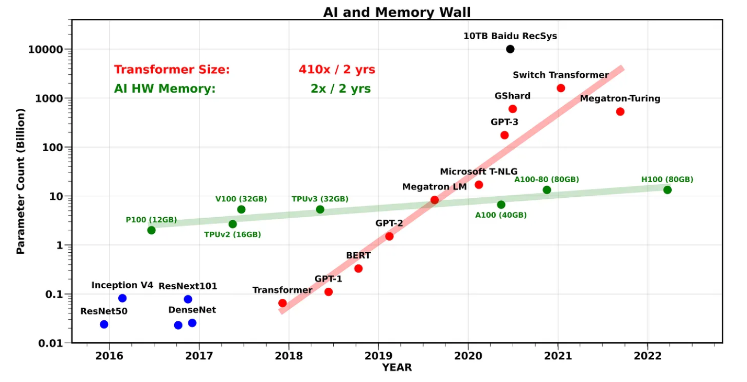

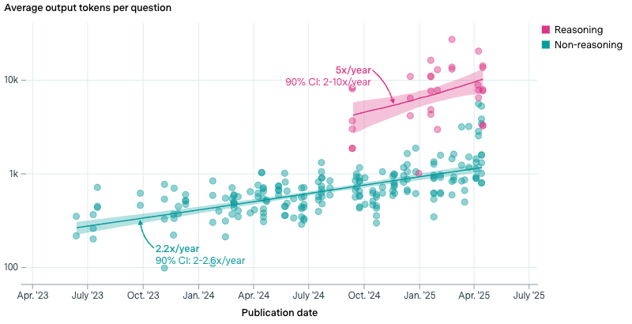
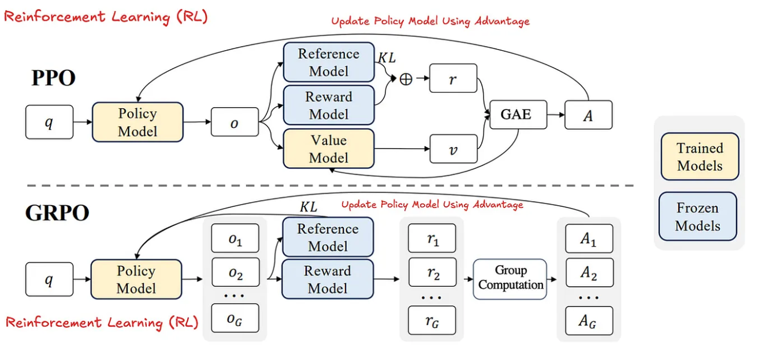
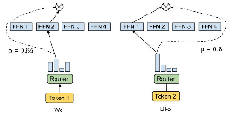
Key Concepts of LLM Software Framework (1/2)
Basics
System
Features: Automation, Abstraction, Backend Portability
Programming Model: Eager Execution v.s. Static Graph
Computation, Memory, and Communication Wall
Algo.
Runtime: Dynamicity at the inference time.
Post-training: DPO, PPO, GRPO, and etc.
Notes:
Basic ML Framework: PyTorch & Tensorflow.
Efficient LLM Training Framework: DeepSpeed, Megatron-LLM, Accelerate
Efficient LLM Inference Framework: vLLM, SGLang, llama.cpp
Flexible Post Training Framework: verl

Slide 6
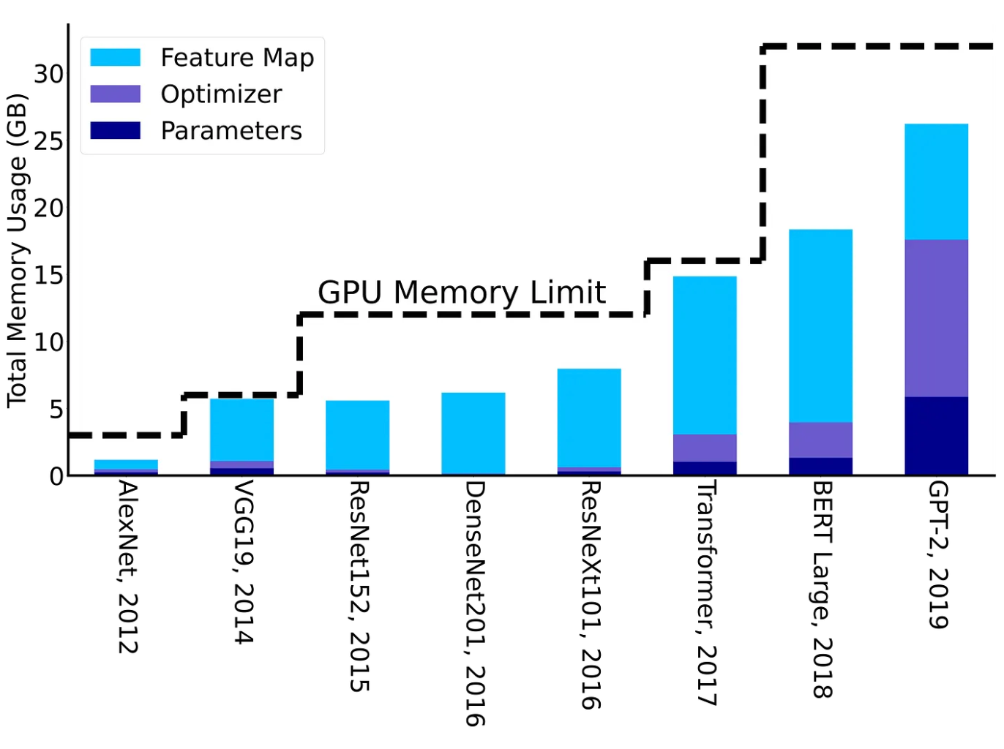
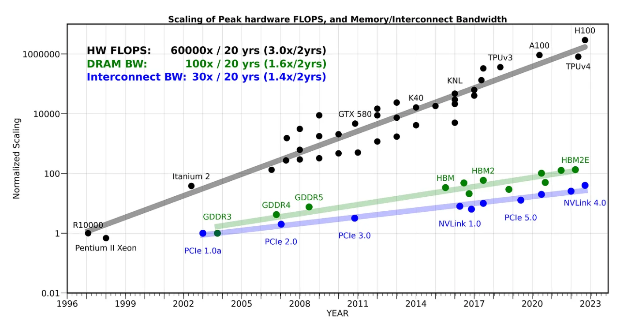
Key Concepts of LLM Software Framework (2/2)
Basics
System
Features: Automation, Abstraction, Backend Portability
Programming Model: Eager Execution v.s. Static Graph
Computation, Memory, and Communication Wall
Algo.
Runtime: Dynamicity at the inference time.
Post-training: DPO, PPO, GRPO, and etc.
Notes:
Basic ML Framework: PyTorch & Tensorflow.
Efficient LLM Training Framework: DeepSpeed, Megatron-LLM, Accelerate
Efficient LLM Inference Framework: vLLM, SGLang, llama.cpp
Flexible Post Training Framework: verl

Slide 7
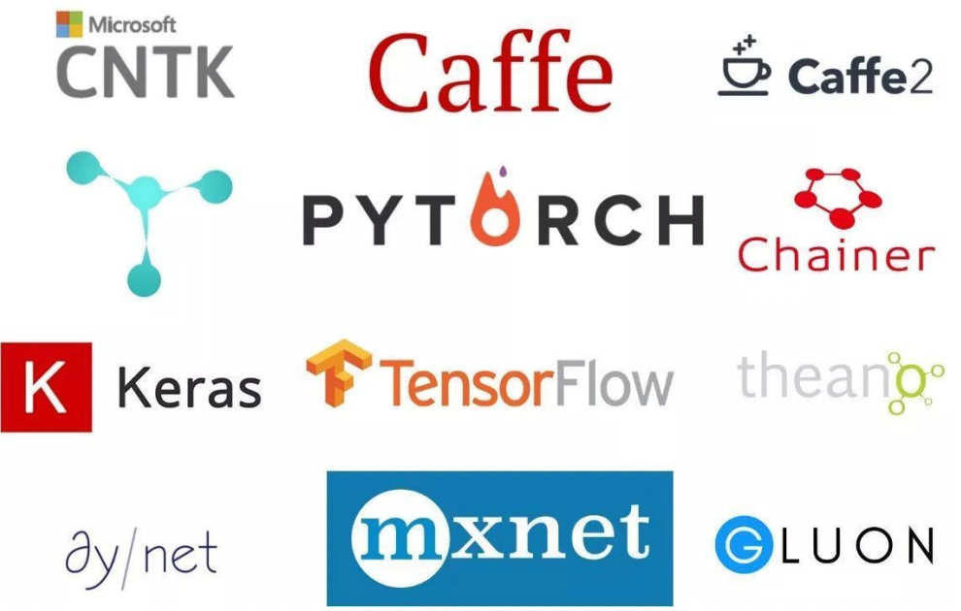
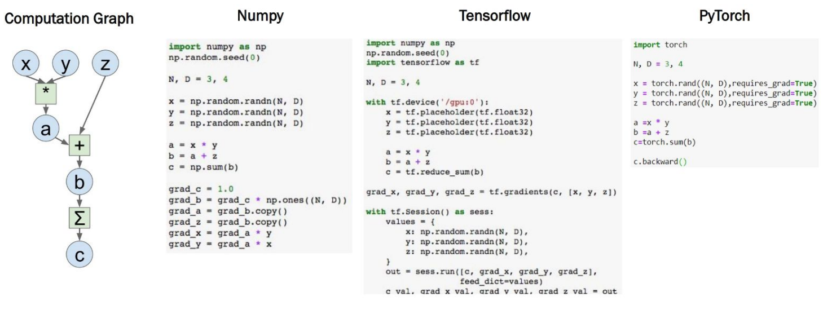
Programming: PyTorch
PyTorch: The (most) popular open-source ML library.
Tensor definition; GPU-enabled computation; Automatic Differentiation; Compiler Support.
Other ML Frameworks
Numpy vs TensorFlow vs PyTorch

Slide 8
Programming: PyTorch – Tensors
Tensors
N-dims array in PyTorch, which is similar with NumPy’s ndarrays.
But torch.Tensor has gradient support and device flag.
Examples: Gradient
t = torch.randn(1)
t.requires_grad_()
or t = torch.randn(1, requires_grad=True)
Access the value: t.data
Access the gradient: t.grad
Notes:
https://sites.cc.gatech.edu/classes/AY2021/cs7650_fall/slides/Introduction_to_PyTorch.pdf

Slide 9
Programming: PyTorch – Tensors
Tensors
N-dims array in PyTorch, which is similar with NumPy’s ndarrays.
But torch.Tensor has gradient support and device flag.
Examples: Hetero-device Support
t = torch.randn(1)
t.to("gpu:1")
torch.cuda.is_available()
torch-npu (by Huawei)
t.to("npu:0")
torch.npu.is_available()
Distributed Support
DTensor & DeviceMesh
Notes:
https://docs.pytorch.org/tutorials/beginner/dist_overview.html

Slide 10
Programming: PyTorch – Autograd
Autograd: Automatic Differentiation Package
No need to worry about partial differentiation, chain rule etc. => backward()
Gradients are accumulated for each step => zero-out gradient after update grad_zero()
Examples: Hetero-device Support
x = torch.tensor(1., requires_grad = True)
w = torch.tensor(2., requires_grad = True)
b = torch.tensor(3., requires_grad = True)
y = w * x + b # y = 2 * x + 3
y.backward()
print(x.grad, w.grad, b.grad) # 2, 1, 1
Notes:
https://sites.cc.gatech.edu/classes/AY2021/cs7650_fall/slides/Introduction_to_PyTorch.pdf

Slide 11
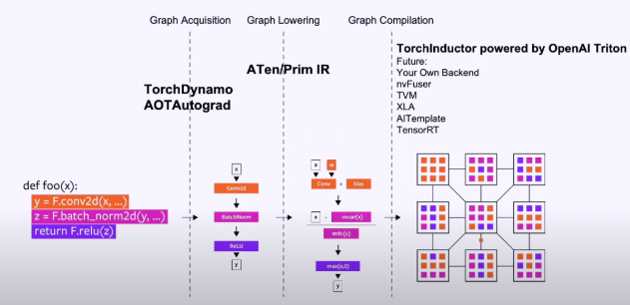
Programming: PyTorch – Inside (1/5)
Enabling a training or inference task is simple. But how about the performance?
At the beginning, one of the design principles of PyTorch – Easy to use > Performance.
With the increase of hardware computing power,
performance, portability, scalability and become more and more important.
So, what is the advanced internal workflow of PyTorch (2.0)?
How can we accelerate?
Compilation Optimization
Graph capturing (acquisition)
Graph lowering
Graph compilation
The backend of PyTorch 2.0
Notes:
https://sites.cc.gatech.edu/classes/AY2021/cs7650_fall/slides/Introduction_to_PyTorch.pdf
https://dl.acm.org/doi/pdf/10.1145/3620665.3640366

Slide 12
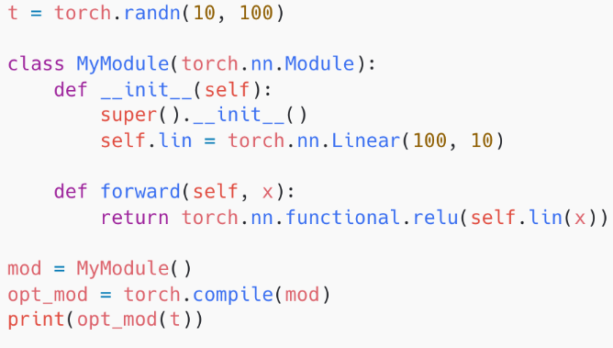
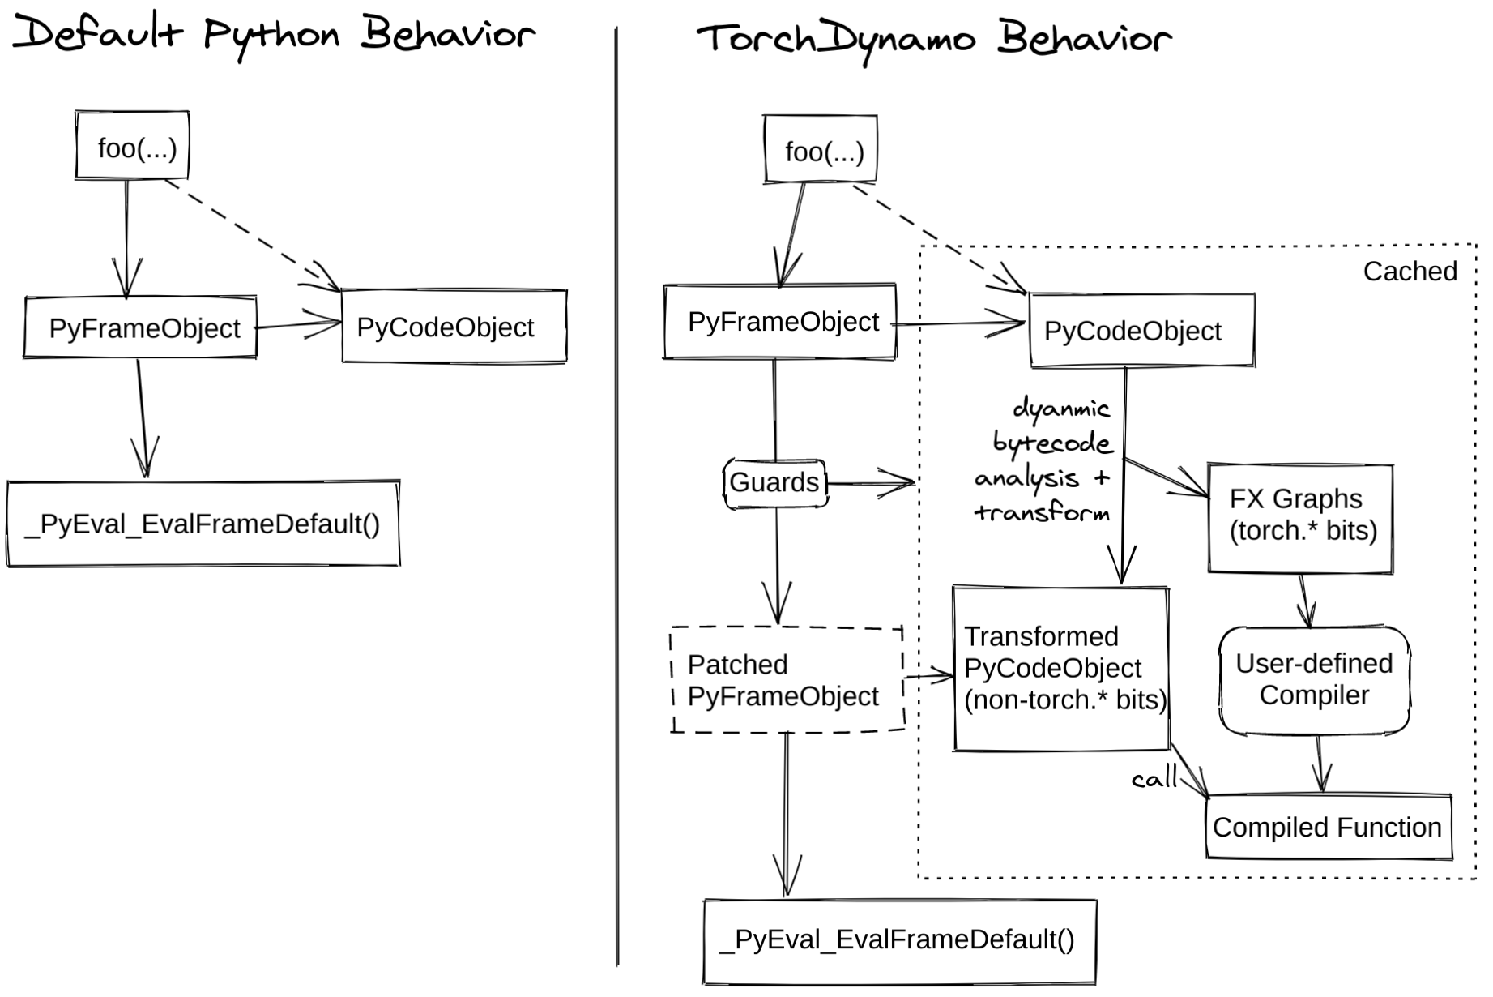
Programming: PyTorch – Inside (2/5)
Unified Entrance @ PyTorch 2.0: torch.compile()
Torch Dynamo (for FP)
A JIT compiler for computation graph extraction.
Before Dynamo, there are several initial tries
TorchScript, TorchFX, LazyTensor, etc
Dynamo has more flexible support combining
with the bytecode and VM.
Graph break when it meets the unsupported ops.
Graph re-compilation checking (@ static shape mode).
Tensor Shape, Stride, Device and etc.
Dynamo also supports dynamic shapes without re-compilation.
AOTAutograd is for the graph extraction during the BP.
Notes:
https://zhuanlan.zhihu.com/p/630933479 https://chips-compilers-mlsys-22.github.io/assets/slides/PyTorch%20Compilers%20(Compiler%20&%20Chips%20Symposium%202022).pdf

Slide 13
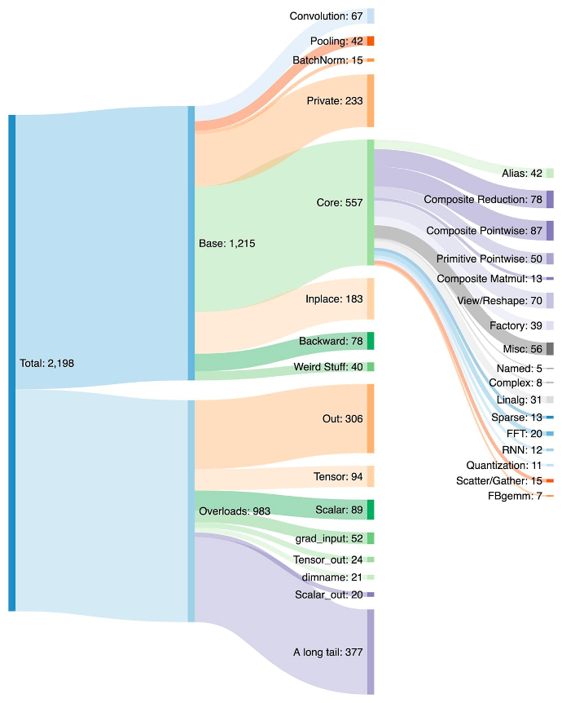
Programming: PyTorch – Inside (3/5)
Unified Entrance @ PyTorch 2.0: torch.compile()
ATen/PrimIR
# ops in PyTorch: 1200+ (2000+ overload ops)
# ops in Prim IR: ~250 (fairly low-level)
# canonical ops in ATen: ~750
Prim IR operators should be fused for better perf.
ATen IR operators
suited for backends that already integrate at ATen level
backends that won’t have compilation to recover performance from a lower-level operator set like Prim ops
Notes:
https://docs.pytorch.org/docs/stable/torch.compiler_ir.html https://pytorch.org/get-started/pytorch-2-x/

Slide 14
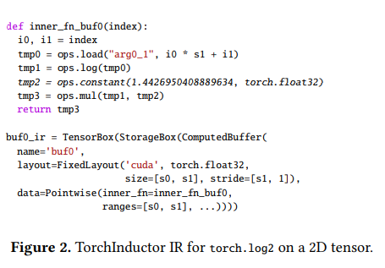
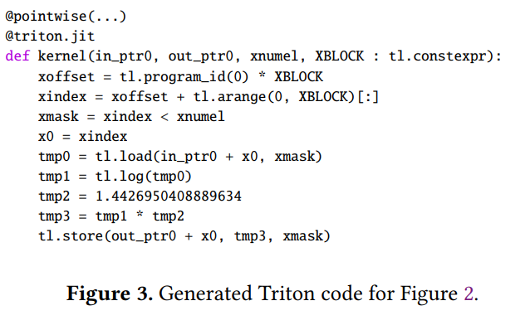
Programming: PyTorch – Inside (4/5)
Unified Entrance @ PyTorch 2.0: torch.compile()
Torch Inductor w/ OpenAI Triton support
The default compiler backend.
Python-native & PyTorch-first.
Loop-level TorchInductor IR has 54 primitive operators.
Define-by-run Concept
IR uses executable Python code to define the bodies of loops
Sympy symbols for the dynamic shapes.
Scheduling: mainly for the operator fusions.
CodeGen: Triton, C++, and wrapper.
Notes:
https://dev-discuss.pytorch.org/t/torchinductor-a-pytorch-native-compiler-with-define-by-run-ir-and-symbolic-shapes/747 这里面最重要的理念是define-by-run

Slide 15
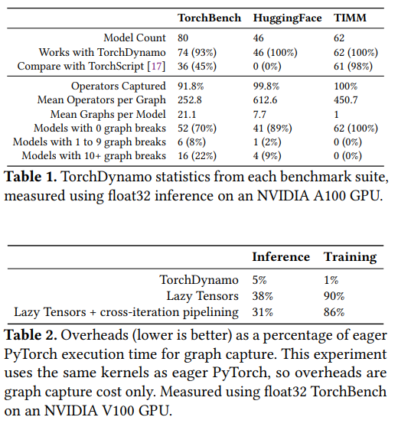
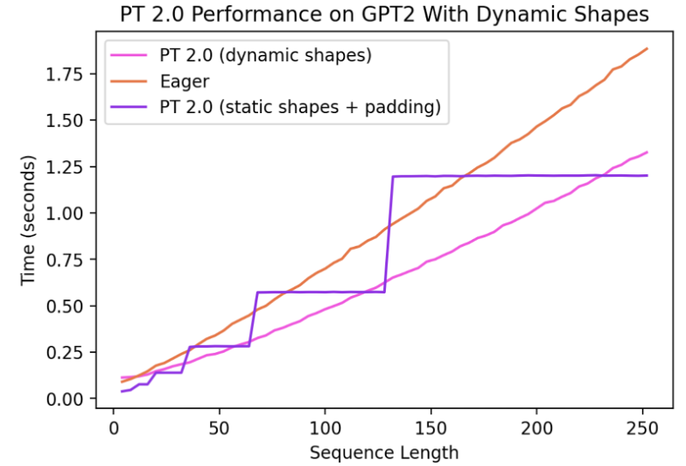
Programming: PyTorch – Inside (5/5)
Evaluations of PyTorch 2.0
Better performance
Dynamic shapes
More model supports
Notes:
https://blog.csdn.net/weixin_38235865/article/details/130085600

Slide 16

The Solution: FlagOS, a Unified AI Software Stack

Slide 17








https://space.bilibili.com/3546791834290849
https://github.com/flagos-ai
https://www.zhihu.com/people/95-22-20-18/posts
https://flagos.io/Home

Slide 18

Thanks for your time！

